Slide 1





Slide 2



Framework
Created in 2014 by:
Creating huge web applications with ubgrading data
Library
Created in 2013 by:
Adaptable user interfaces and sophisticated single-page applications
Framework
Created in 2009 by:
Building highly interactive web applications

Slide 3
Framework
Created in 2009 by:
Building highly interactive web applications

Slide 4

HOW DOES IT WORK?
HOW DOES IT WORK?
Uses JavaScript
A skeleton for web applications
Works on MVW model
Allows reconciling JS and MVC model
https://en.wikipedia.org/wiki/Model–view–controller#/media/File:MVC-Process.svg

Slide 5
+ AND – OF ANGULAR
HOW DOES IT WORK?
Has a too many realeses: from JS Framework to Angular 11 based on JS
Higher entry threshold due to a lot of material to master right away
Great for advanced projects
Intuitive setup
Easier work because of TypeScript
Works also as skeleton for apps

Slide 6
Framework
Created in 2014 by:
Creating huge web applications with ubgrading data
Library
Created in 2013 by:
Adaptable user interfaces and sophisticated single-page applications
Framework
Created in 2009 by:
Building highly interactive web applications

Slide 7
Framework
Created in 2014 by:
Creating huge web applications with ubgrading data

Slide 8

VUE – WHAT IS IT?
Uses JavaScript (and TypeScript)
Considered as child of React and Angular
Uses MVC
Works with CBA

Slide 9
+ AND – OD VUE
Easy to learn and use
Very efficient
Good and intuitive documentation
No advanced knowlage needed
Low popularity
Less resources than other frameworks

Slide 10
Framework
Created in 2014 by:
Creating huge web applications with ubgrading data
Library
Created in 2013 by:
Adaptable user interfaces and sophisticated single-page applications
Framework
Created in 2009 by:
Building highly interactive web applications

Slide 11
Library
Created in 2013 by:
Adaptable user interfaces and sophisticated single-page applications

Slide 12
STARTED BY FB?
Uses JavaScript
Component-based
Has „Styled Components”
Created by facebook worker

Slide 13
+ AND – OF REACT
Easy to learn and use
Large group working on its development
The most popular out of mentioned
Not much expended documentation
Because of typing styles in style components, project quickly gains code

Slide 14
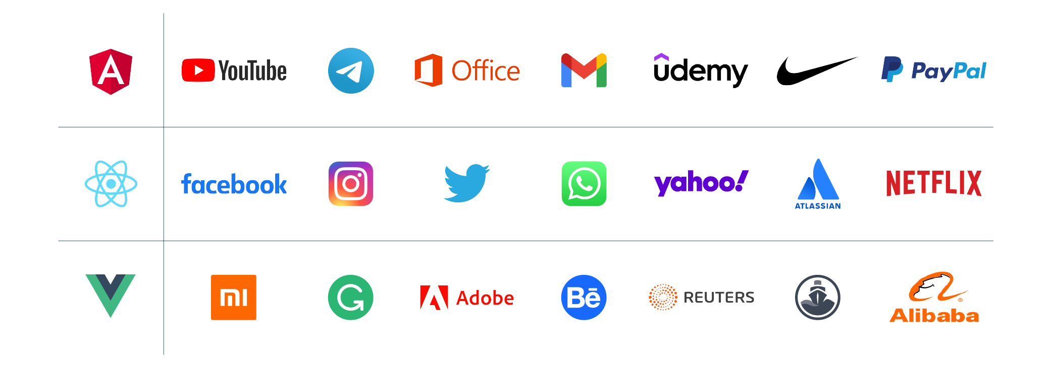
https://pleodigital.com/blog/artykuł-angular-vs-vue-js-vs-react

Slide 15


